Slide 1

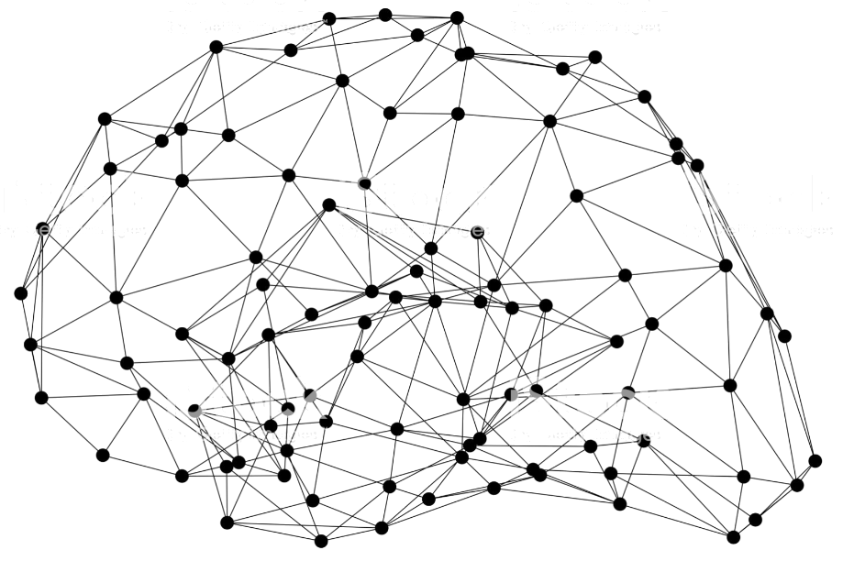
Summary
Notes:
Today we showed many examples and tutorials to use and train a state-of-the-art computer vision models. Due to time constraints we may not cover all contents and we probably just have showed some older models due to their simplicity for demo purposes. Please check out the GluonCV github repo and website offline to make sure you get your most interested contents that we didn’t cover today.

Slide 2
One more thing: GluonCV + AutoML
Available: Mid November
Notes:
We know that automation is important. We will have a deeply integrated toolkit for tuning CV models and perform efficient architecture search that is no longer painful and costy.
Stay tuned and it will be available soon in Mid November!

Slide 3

Like GluonCV? Go build!
https://github.com/dmlc/gluon-cv
https://gluon-cv.mxnet.io

